Slide 1
KeyStone II - Connectivity
Description of internal connectivity
Teranet bridges
Set Teranet priorities

Slide 2
Internal Buses
Configuration Teranet
Data Teranet
We concentrate on the Data Teranet
Masters and Slaves
Masters can initiate transfer (put address on the address bus)
No contention on a master
Slaves respond to master requests
Slaves may have multiple requests from multiple masters

Slide 3
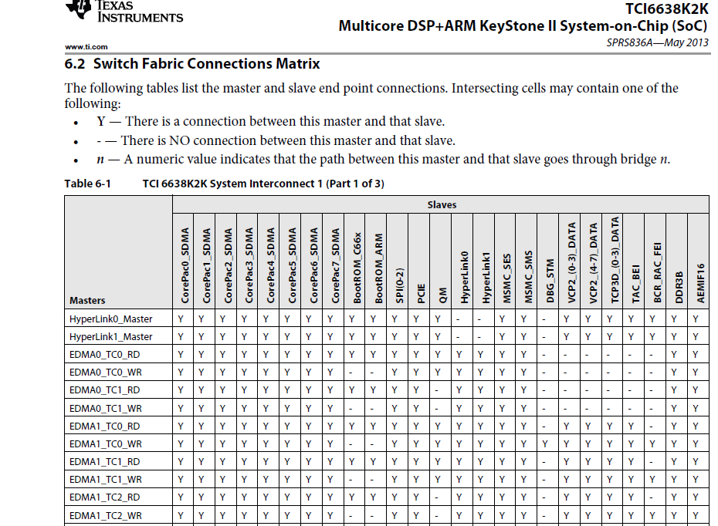

Slide 4
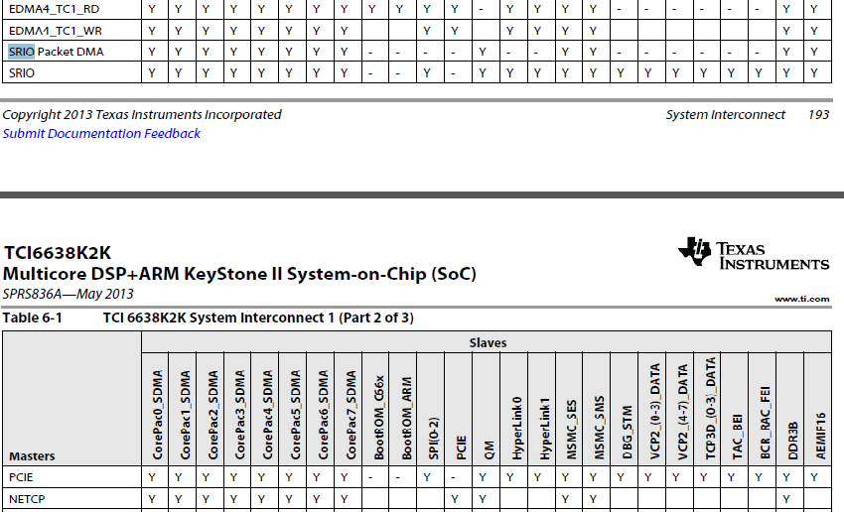

Slide 5
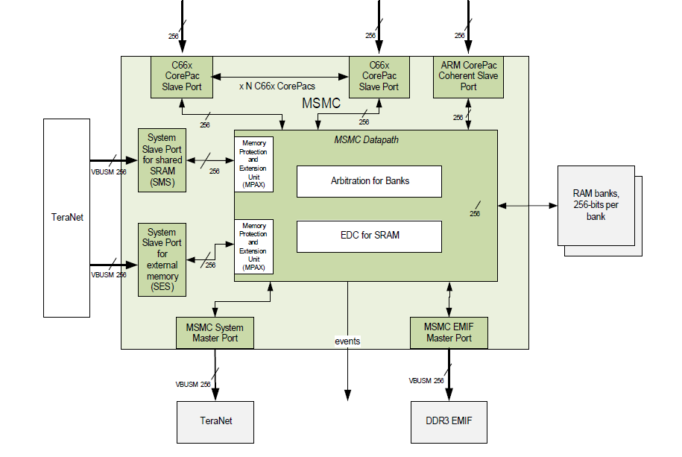
KeyStone II MSMC interfaces

Slide 6
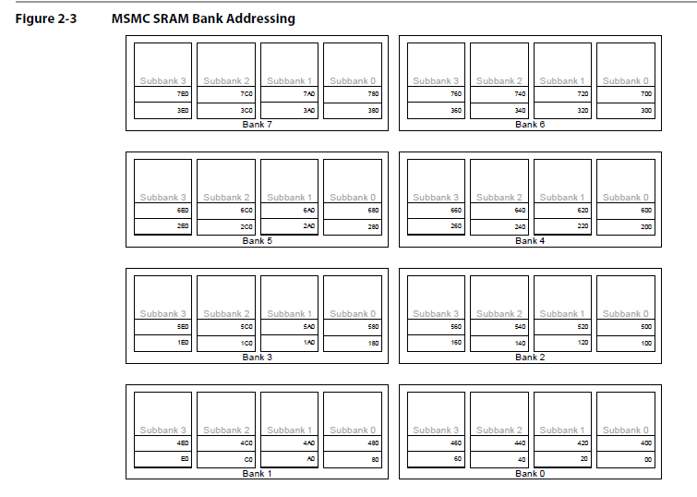
MSMC SRAM Banks (4x32)

Slide 13
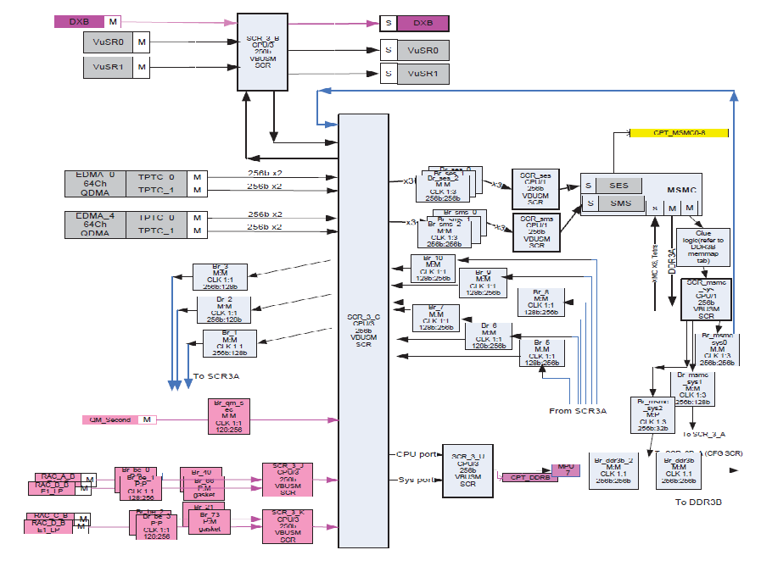

Slide 14
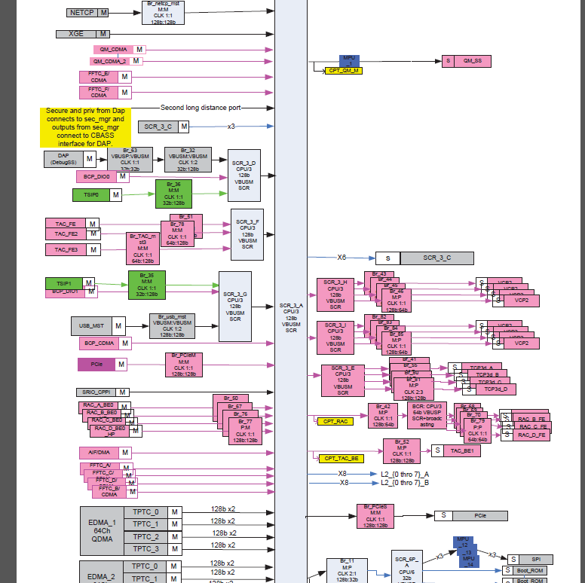

Slide 15
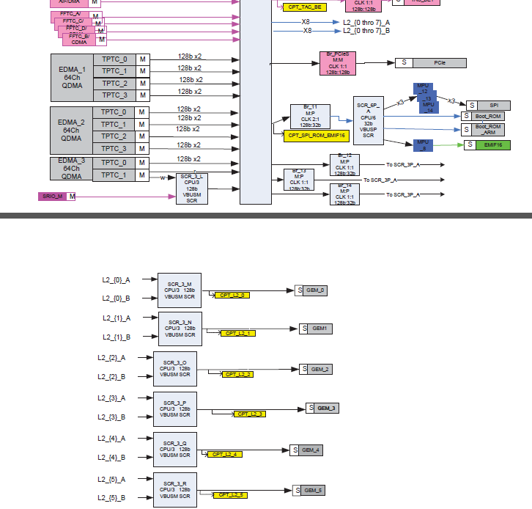

Slide 16
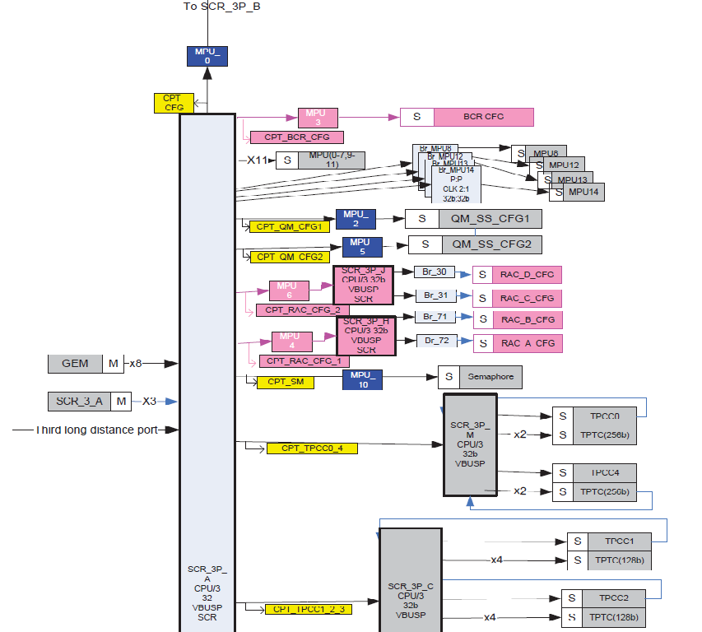

Slide 17
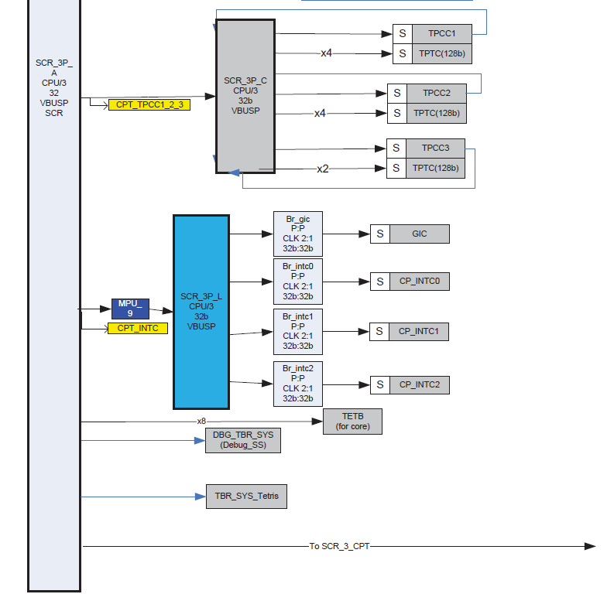

Slide 18
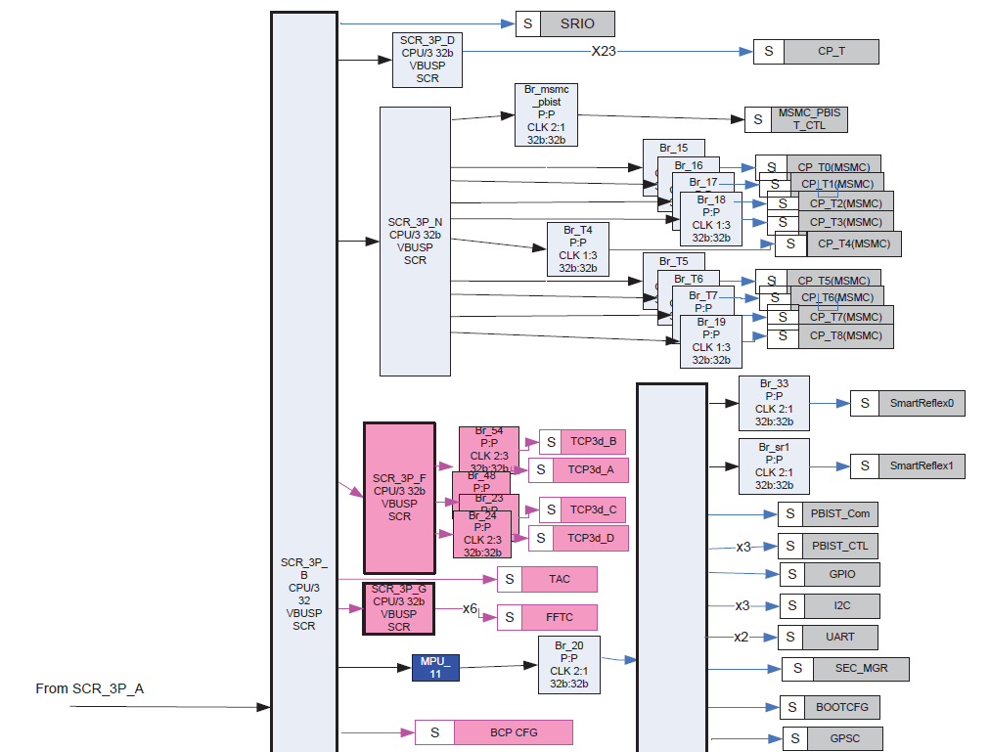

Slide 19
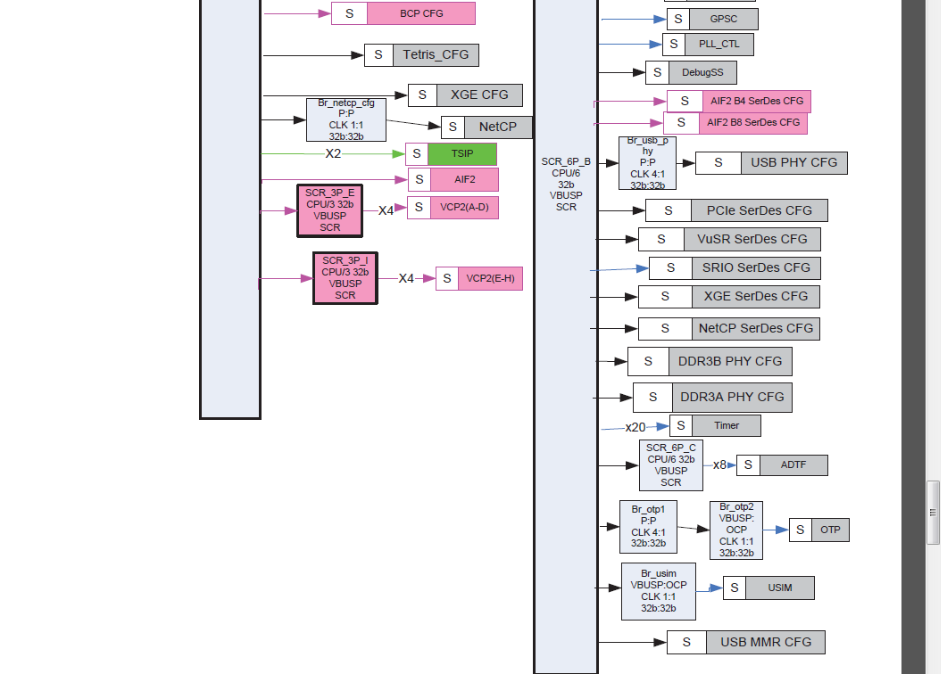

Slide 20
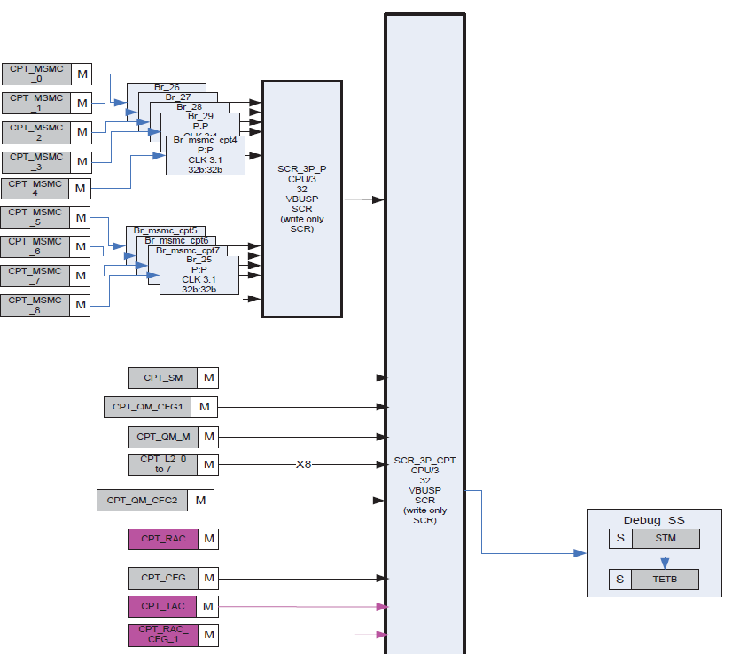

Slide 21
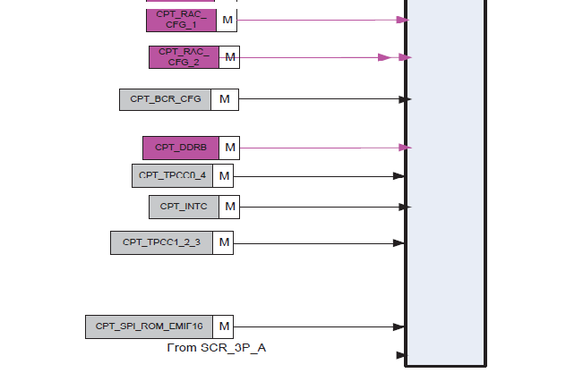

Slide 22
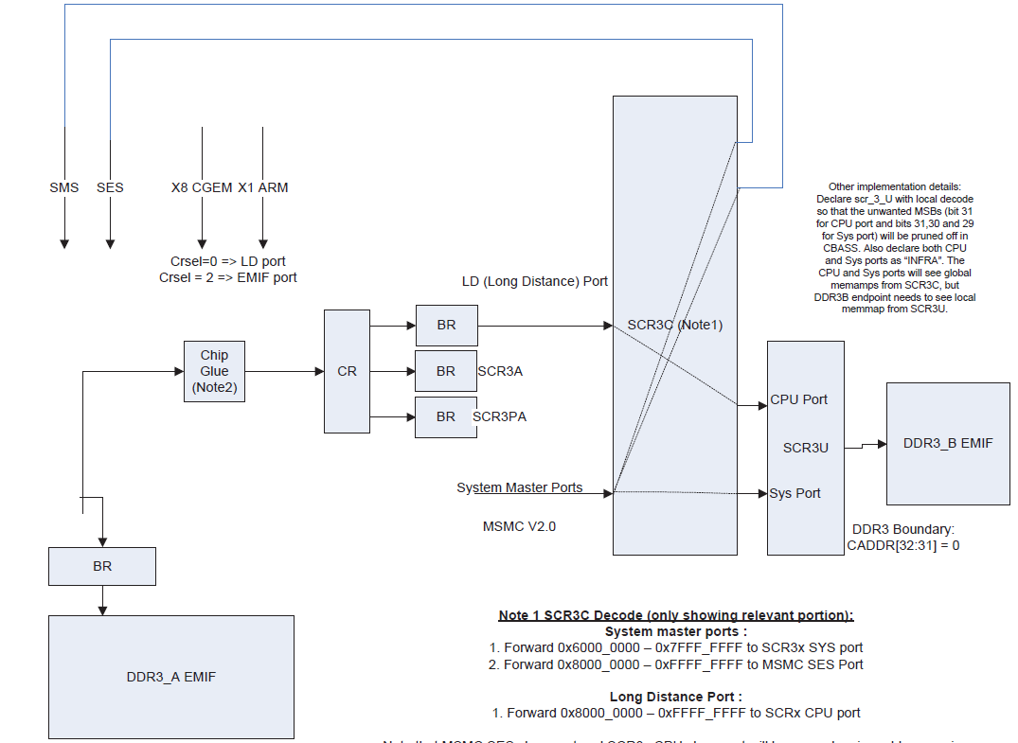

Slide 23
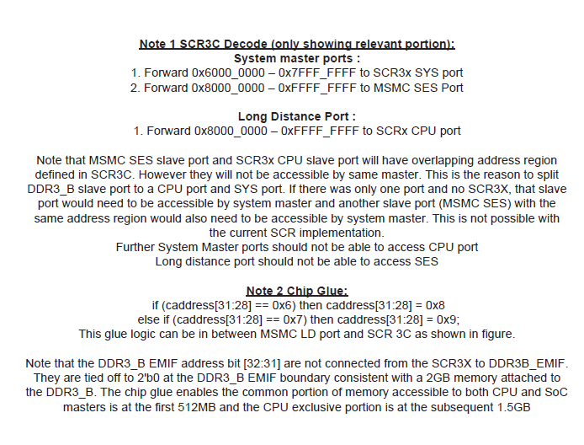

Slide 24
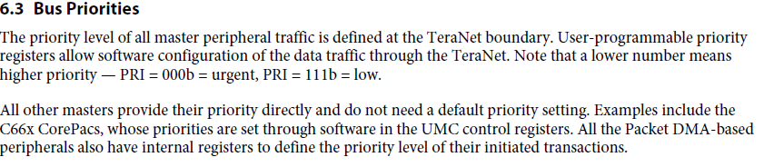
Priorities
From the User’s Guide:

Slide 25
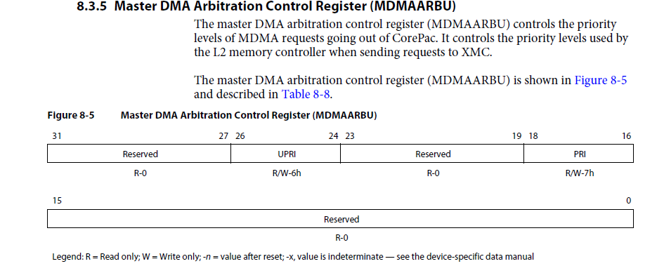
DSP Priorities

Slide 26
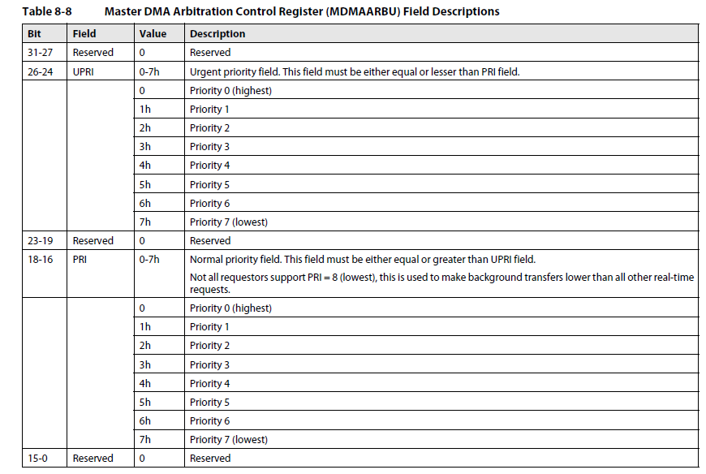
DSP Priorities

Slide 27
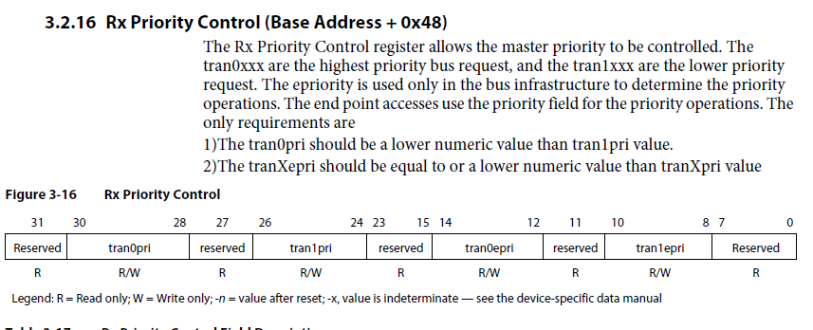
Hyperlink Priority Register

Slide 28
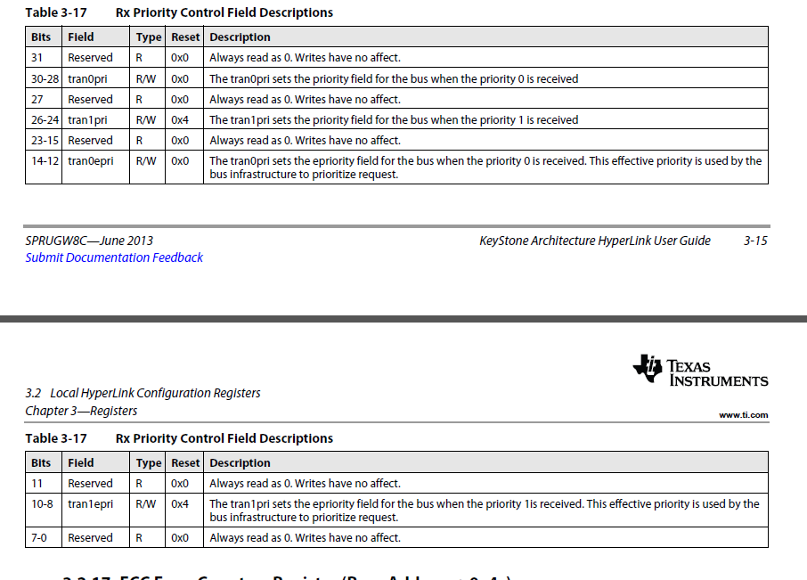
Hyperlink Priority Register

Slide 29
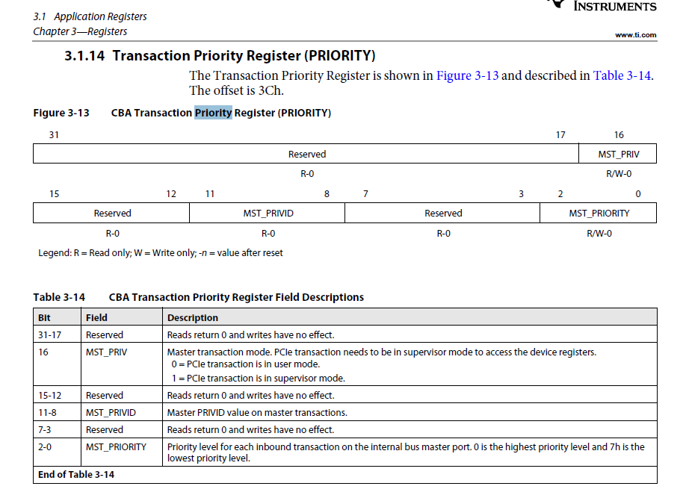
PCIe Priority Register

Slide 30
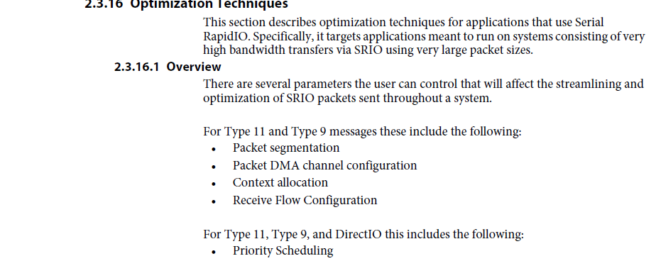
SRIO Priority Register (1/3)

Slide 31
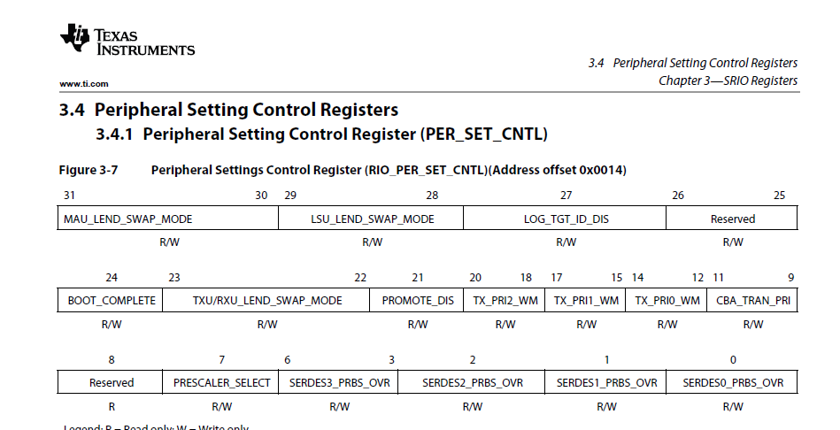
SRIO Priority Register (2/3)

Slide 32
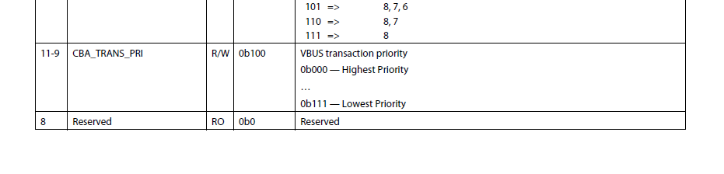
SRIO Priority Register (3/3)

